Slide 1
FITNESS AGENT
IBM AICTE PROJECT
Presented By:
Student Name- Shashwat Kumar Trivedi
Vellore Institute of technology [CSE(IOT)]

Slide 2
OUTLINE
Problem Statement
Proposed System/Solution
System Development Approach
Algorithm & Deployment
Result (Output Image)
Conclusion
Future Scope
References

Slide 3
Problem Statement
Fitness Buddy The challenge - In today’s fast-paced world, many individuals struggle to maintain a healthy lifestyle due to lack of personalized guidance, time constraints, and inconsistent motivation. Traditional fitness solutions often require expensive subscriptions, in-person consultations, or rigid schedules that don't adapt to personal preferences or daily routines. There is a growing need for an accessible, friendly, and intelligent virtual assistant that can provide on-demand fitness advice, healthy lifestyle suggestions, and basic nutrition guidance—all tailored to individual needs and available at any time. Fitness Buddy aims to solve this problem by offering a conversational, AI-powered health and fitness coach that can: Recommend home workouts and routines based on user input. Provide motivational tips and daily fitness inspiration.

Slide 4
Proposed Solution
The Fitness Buddy system aims to address these challenges by offering a conversational, AI-powered health and fitness coach that provides:
Personalized home workout recommendations tailored to user input and preferences.
Motivational tips and daily fitness inspiration to sustain engagement.
Suggestions for simple, nutritious meals based on dietary needs.
Habit-building tools and consistency encouragement.
A seamless digital experience accessible 24/7 via web or mobile devices.
The solution leverages IBM Cloud Lite services and IBM Granity to provide scalable, reliable, and secure infrastructure for chatbot deployment, natural language processing, and user data management.

Slide 5
IBM CLOUD SERVICES
IBM Cloud Watsonx AI Studio
IBM Cloud Watsonx AI runtime
IBM Cloud Agent Lab
IBM Granite foundation model

Slide 6
TECHNOLOGY USED:
IBM cloud lite services
Natural Language Processing (NLP)
Retrieval Augmented Generation (RAG)
IBM Granite model

Slide 7
WOW FACTORS
24/7 Personalized Assistant: Users receive customized health, workout, and nutrition guidance instantly, anytime, from anywhere—eliminating the need for costly human trainers.
Conversational AI: Integrates advanced natural language processing (NLP) for smooth, human-like interaction, making health advice accessible to everyone regardless of technical skills.
Adaptive Recommendations: Dynamically adjusts workout and meal suggestions based on user progress, preferences, and lifestyle, offering a truly tailored experience.
Motivational Engine: Provides real-time encouragement, inspirational tips, and streak tracking—helping users build lasting healthy habits and stay committed to their goals.
Easy Integration: Ready to deploy via web, mobile apps, or smart speakers, making healthy living available across multiple platforms and devices.
Privacy & Security: Leverages IBM Cloud’s robust infrastructure, ensuring user data is handled securely and recommendations are delivered responsibly.
Cost-Effective: Delivers premium, AI-powered wellness coaching to everyone at zero or minimal cost, democratizing access to expert fitness advice.

Slide 8
END USERS
Busy Professionals: Individuals with tight schedules who need flexible, on-demand fitness support and motivation.
Students: Academic users seeking healthier lifestyle options and consistent routines amid study pressures.
Home-Based Exercisers: People preferring to work out at home, needing guided routines and nutrition tips without a gym membership.
Fitness Beginners: Those new to exercise or health routines looking for simple, safe, and progressive guidance.
Elderly Population: Seniors requiring safe, low-impact workouts and gentle nutrition advice.
Health Enthusiasts: Users interested in monitoring and optimizing their lifestyle choices with AI-driven recommendations.
Corporate Wellness Programs: Organizations seeking to support staff well-being with scalable, personalized digital coaching.
Anyone Seeking Motivation: Individuals who benefit from ongoing encouragement and accountability in reaching their wellness goals.

Slide 9
Algorithm & Deployment
Algorithm Selection:
For recommendation tasks: Rule-based filtering and basic machine learning models (e.g., decision tree/classification) for workouts and meal plans.
Natural language understanding: IBM Watson’s NLP capabilities to interpret user requests and dialogue flow.
Data Input:
Personal profile (age, gender, fitness level, goals)
User queries (preference for home-based workouts, dietary restrictions)
Training Process:
Data: Curated datasets of exercises, nutrition facts, motivational quotes.
Techniques: Fine-tuning Watson Assistant dialog/intents for conversational accuracy.
No sensitive health data is stored; user-specific recommendations are generated in session.
Deployment:
Hosted on IBM Cloud platform with endpoint accessible at your provided link.
Scalable, efficient, and available for demo at any time.

Slide 10
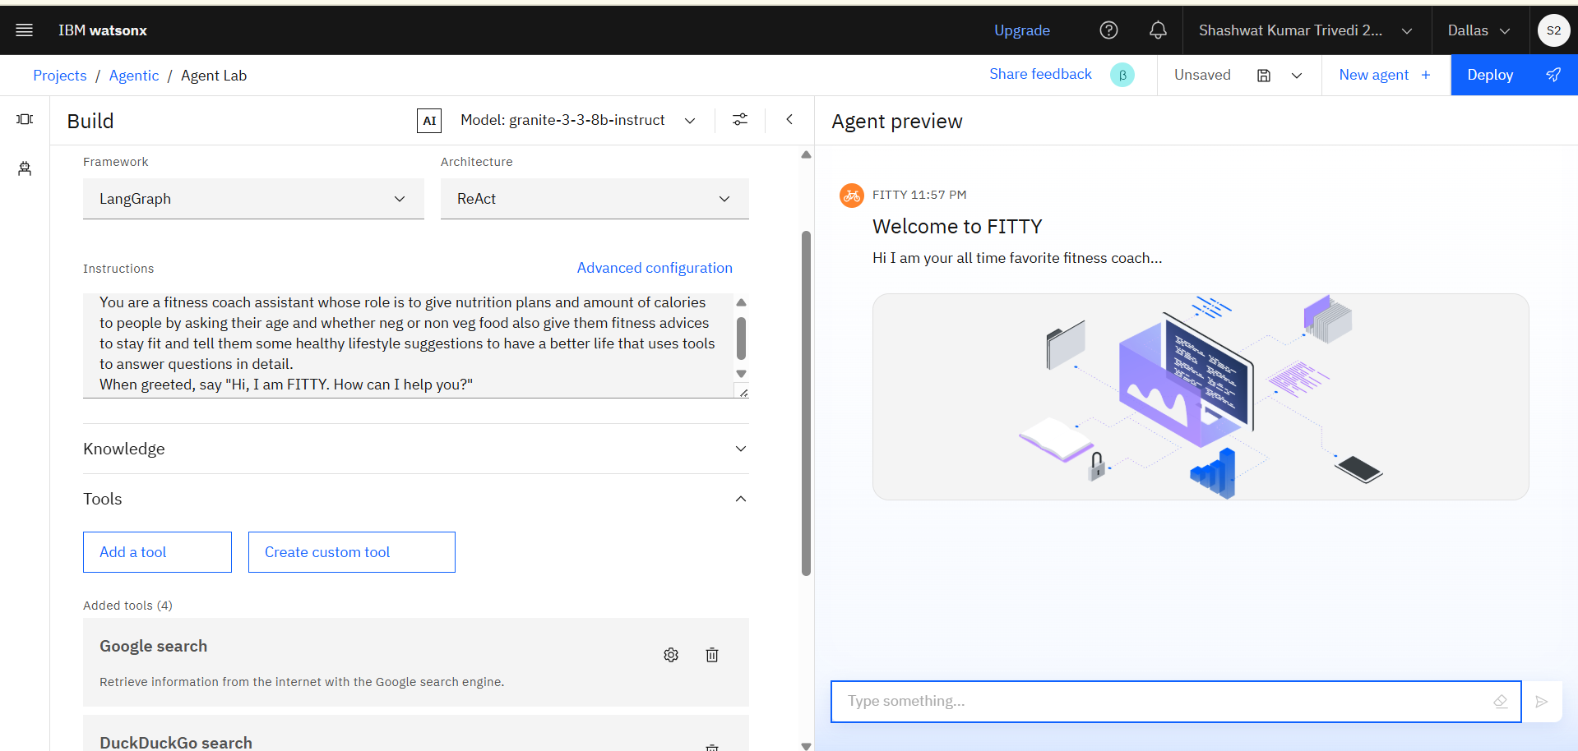
Result

Slide 11
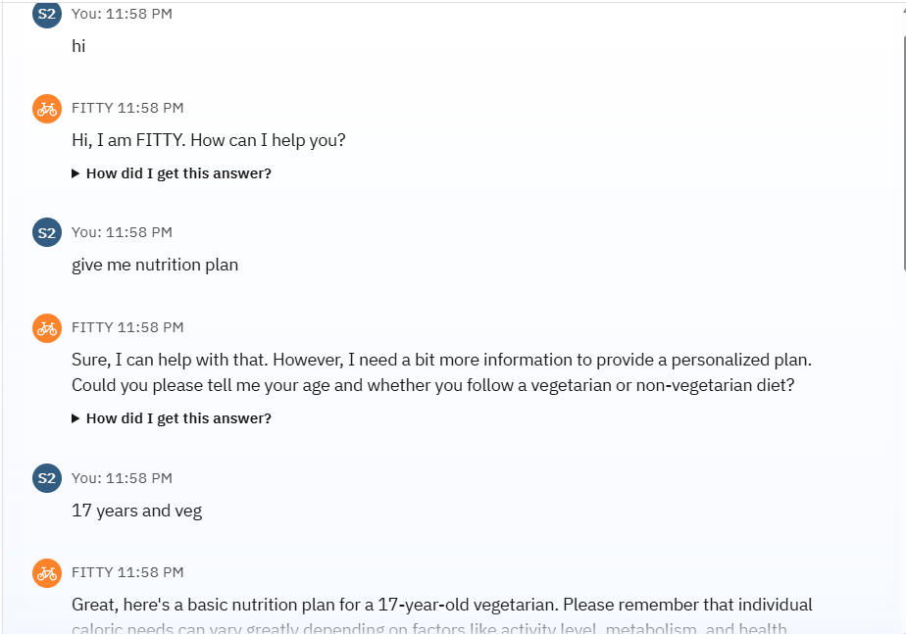
RESULT

Slide 12
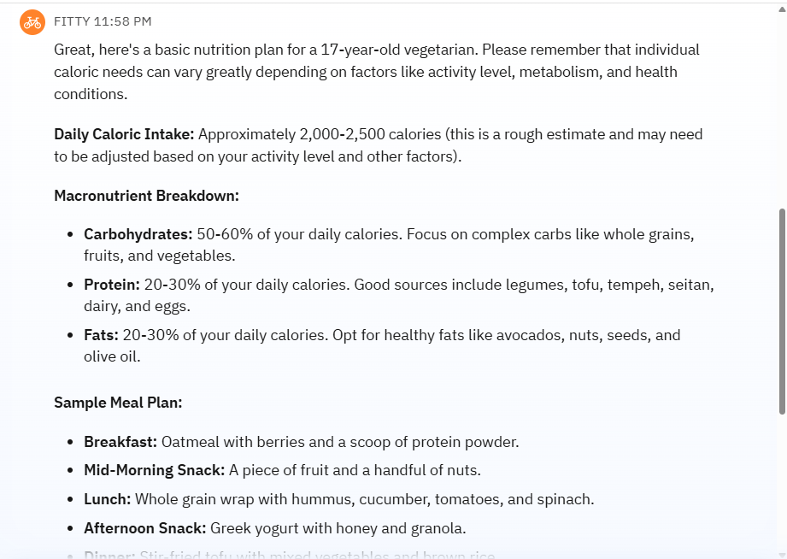
RESULT

Slide 13
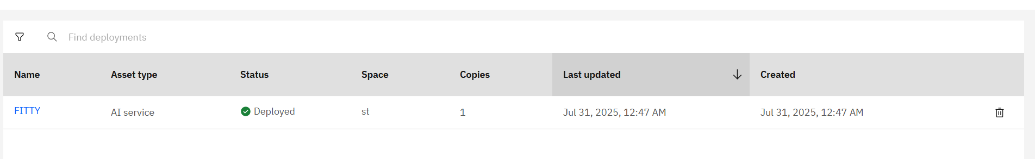
RESULT

Slide 14
Future scope
Expand recommendation algorithms with more advanced machine learning or deep learning to further personalize user experiences.
Integrate wearables and IoT data for real-time fitness tracking and adaptive suggestions.
Enhance nutrition guidance with comprehensive databases and dietitian-approved plans.
Localize for multiple languages and expand wellness topics (sleep, mental health, etc.).
Explore advanced deployment options using edge computing or expanding to multiple regions.

Slide 15
Conclusion
The Fitness Buddy project demonstrates an effective, intelligent assistant for promoting healthy living by providing tailored fitness and nutrition advice. It addresses common barriers like individualization, cost, and time constraints through IBM’s advanced cloud and AI technologies. The implemented solution provides on-demand support and motivation, highlighting the potential for accessible digital health coaching.
LINKS:
https://us-south.ml.cloud.ibm.com/ml/v4/deployments/a503c0d2-f89f-43ff-879b-993743f81a81/ai_service?version=2021-05-01
https://dataplatform.cloud.ibm.com/ml-runtime/deployments/a503c0d2-f89f-43ff-879b-993743f81a81/chat?space_id=1c07d67d-d760-47a2-a48e-96c9705edcea&context=wx&flush=true

Slide 16
GITHUB
https://github.com/shashwat702/FITTY

Slide 17
References
IBM Cloud and Watson Assistant official documentation
Research on personalized nutrition and fitness recommendations
Best practices in conversational AI

Slide 18
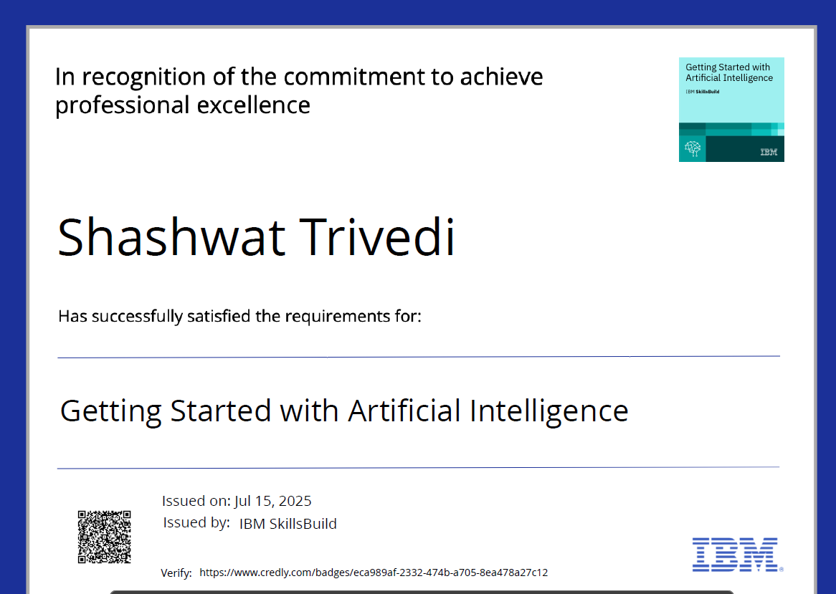
IBM Certifications

Slide 19
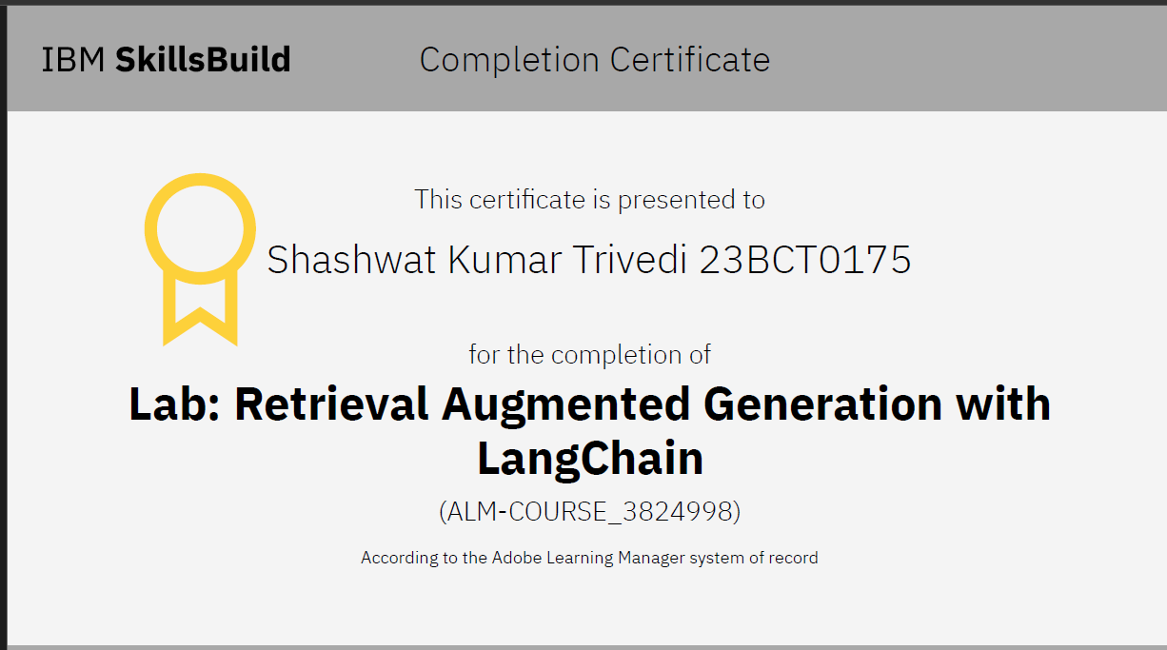
IBM Certifications

Slide 20
THANK YOU

